Slide 1
The energetics of strategy changes in the prefrontal cortex

Slide 2
Background
Neural computations are energetically demanding. The brain is responsible for about 30% of our metabolic demand
Spikes are especially costly (require a lot of ATP), so spiking computations are likely driving a lot of this demand.
Cognitive flexibility is compromised when energy bioavailability is compromised.
Perhaps this is because it takes a lot of energy to change our minds.
But what are the energetic demands of flexibility and what does this look like neurally?

Slide 3
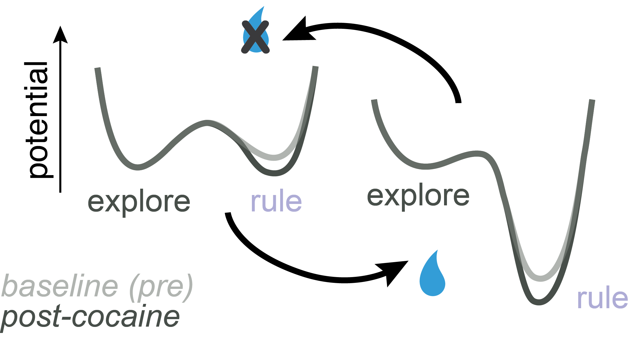

Prior work: Rules are energy minima
Ebitz, et al, PLoS Comp Biology 2019

Slide 4
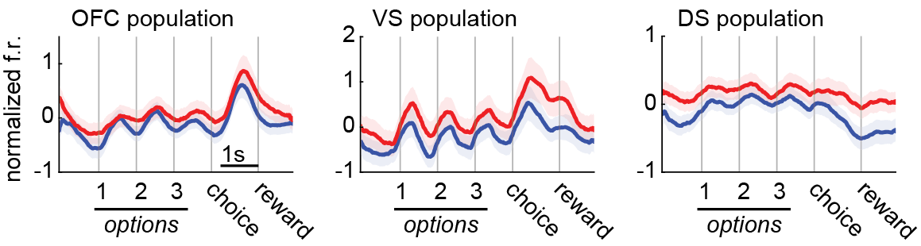
Prior Work: Lower spike rates for rules
Ebitz, et al, PLoS Biology 2020

Slide 5
Next steps:
We previously speculated that lower spike rates are due to computational efficiency of rules, which could be part of why we use them
But this could also be a general purpose thing: energetically-demanding behavior (in the thermodynamic sense) could be rare because it has outsized neuro-metabolic demands
So ....

Slide 6
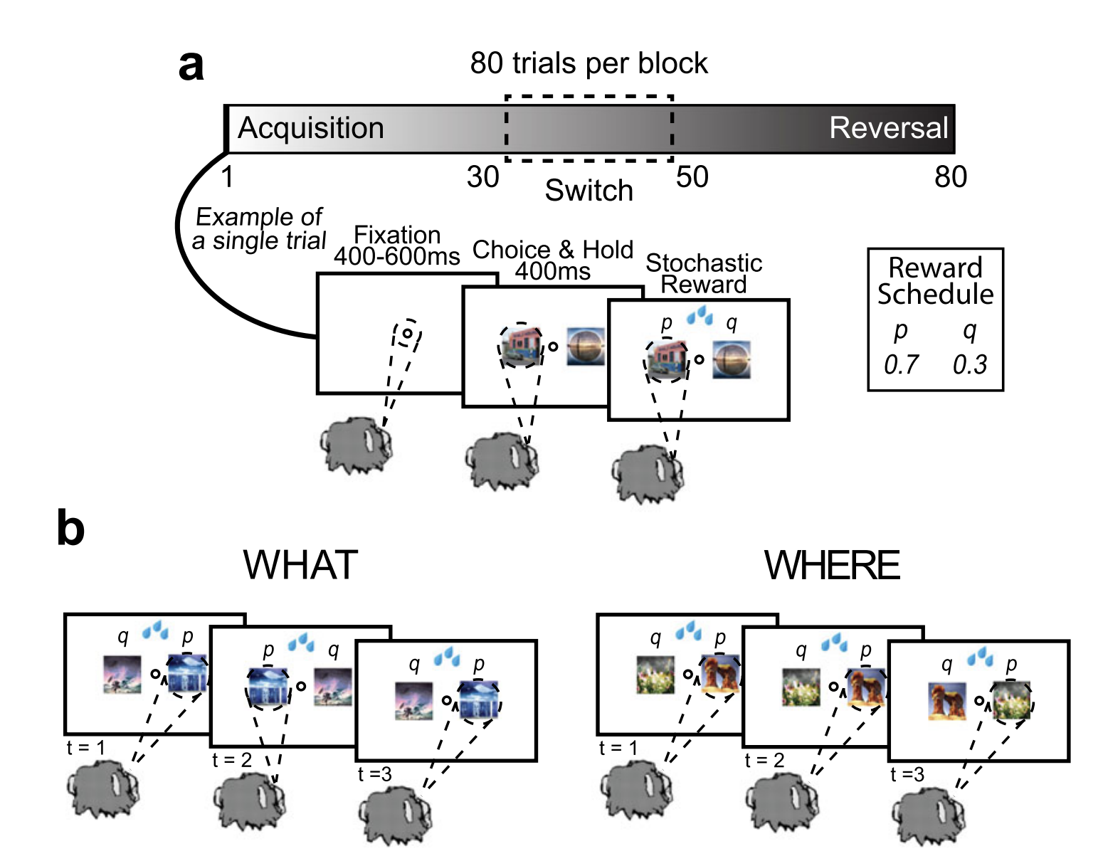
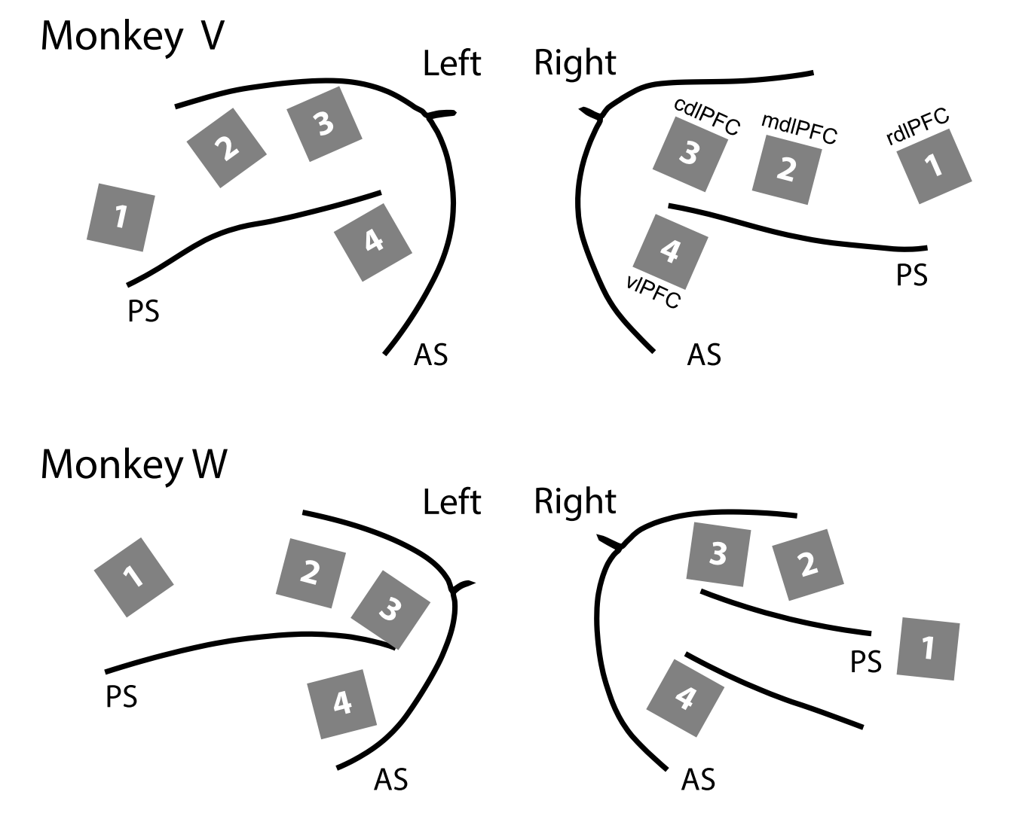
Task design and dataset
data: Bartolo & Averbeck, Neuron 2020;
Tang, Bartolo, Averbeck, Nat Comms 2021
x768 electrodes/monkey

Slide 7
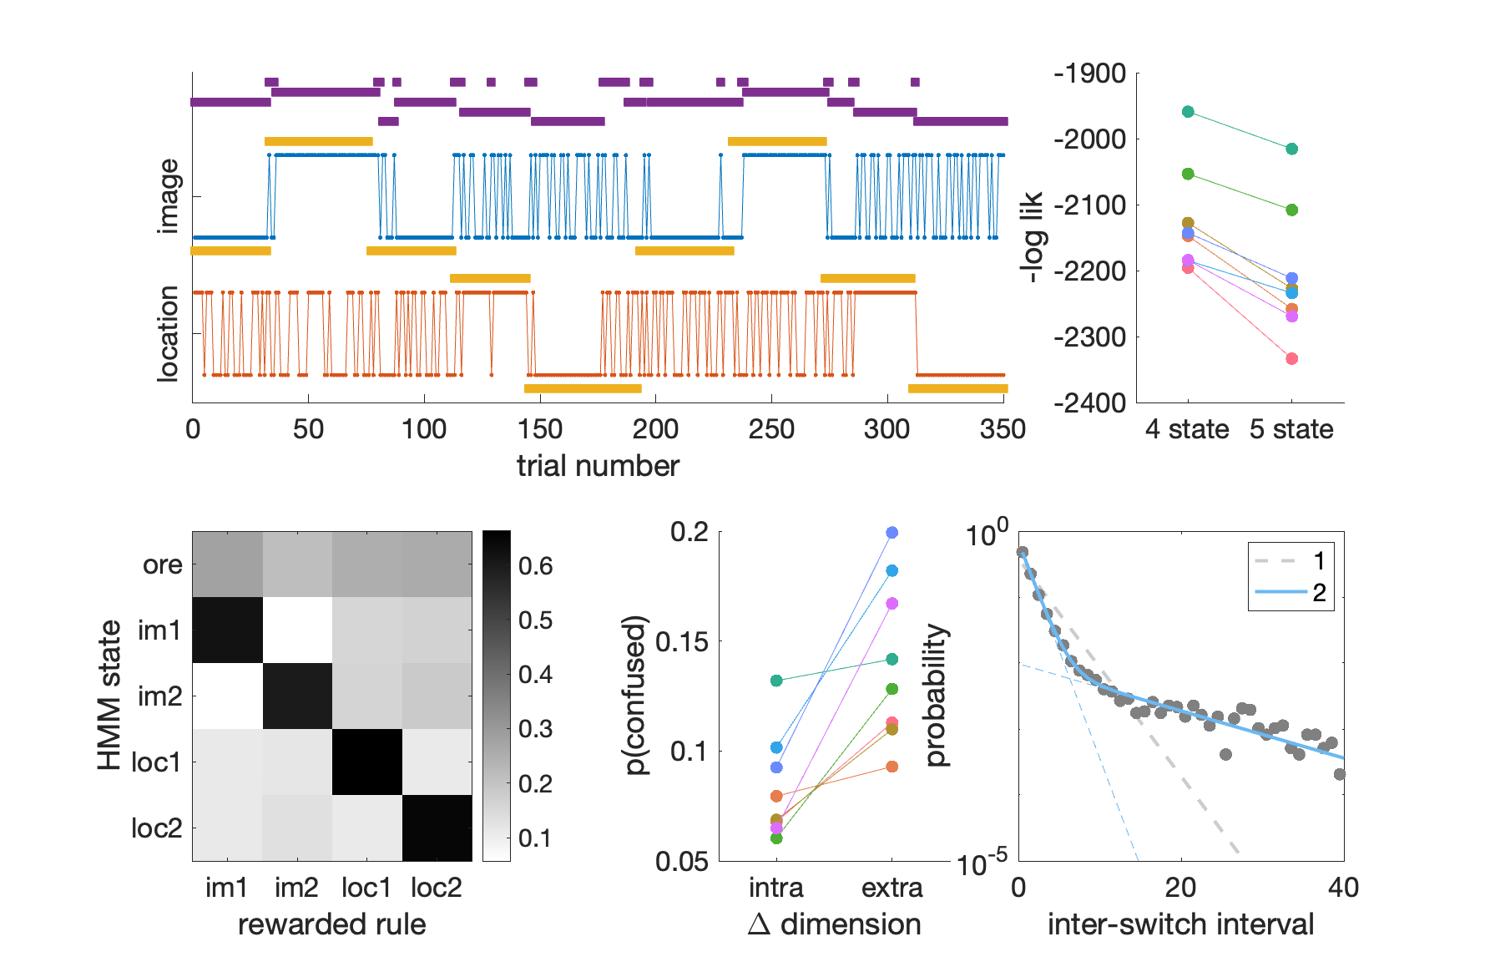
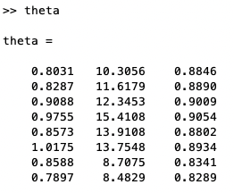
Evidence for an explore state
There are 2 switching time constants, but the short switches occur more frequently than would be expected if random decision making in 1 dimension only occurred during persistent decisions in another domain (compare 4 state and 5 state models)

Slide 8
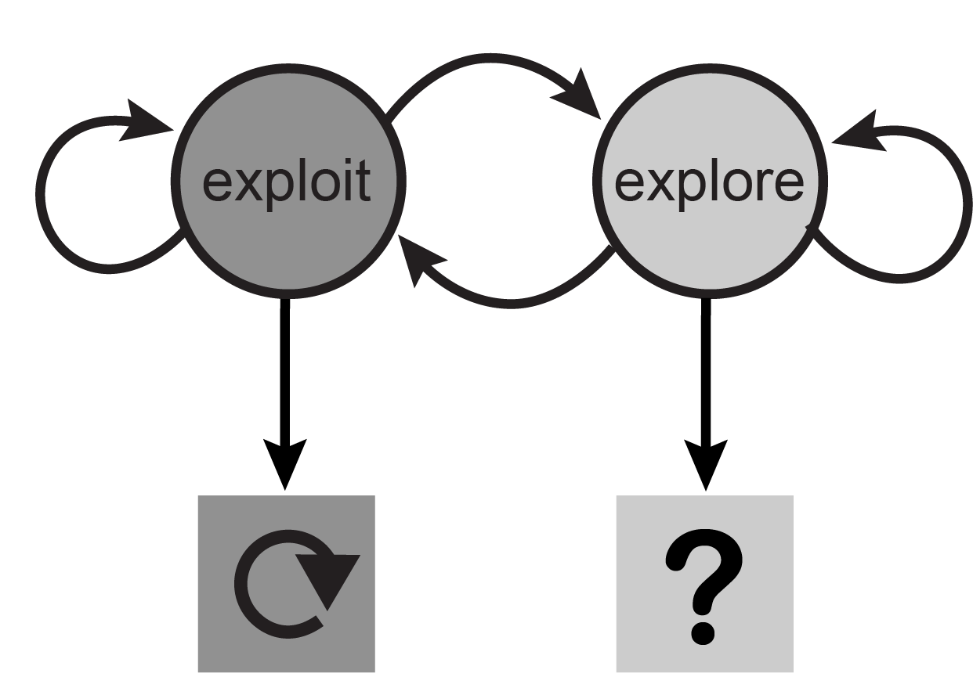
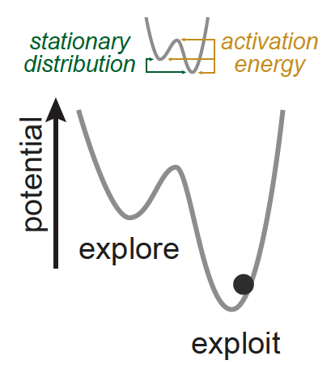
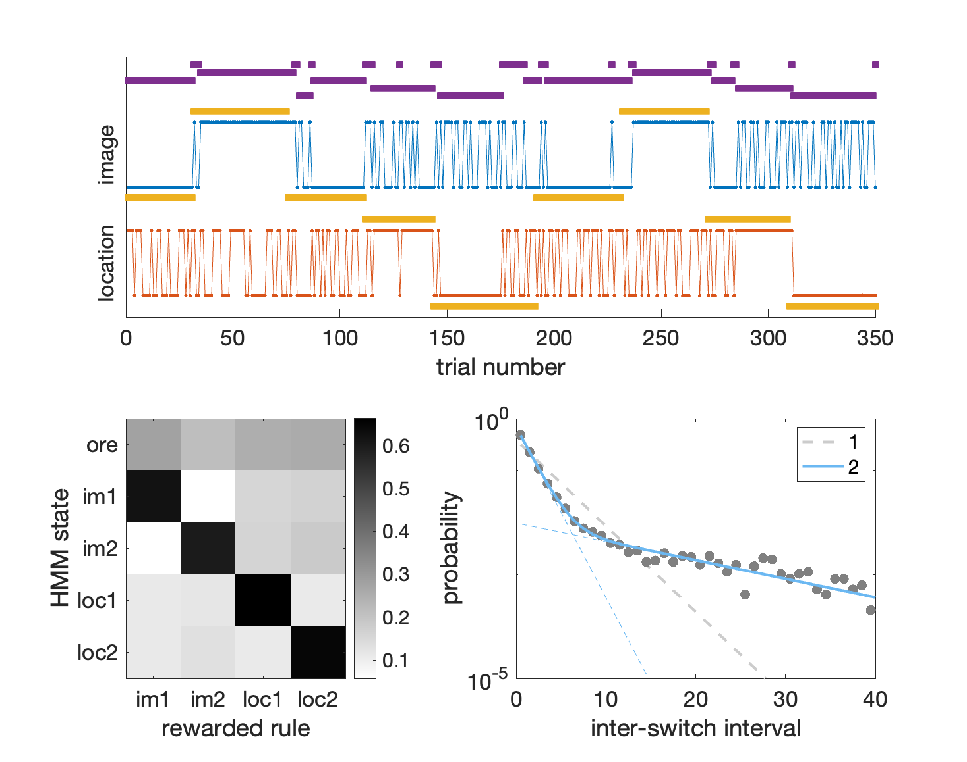
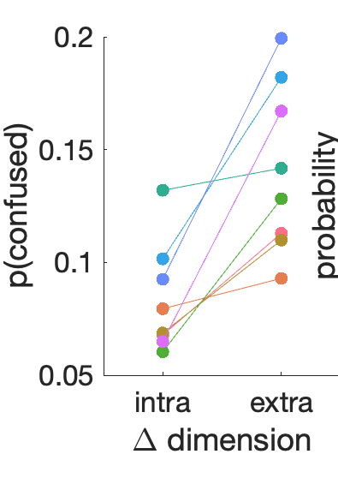
Hidden Markov model

Slide 9
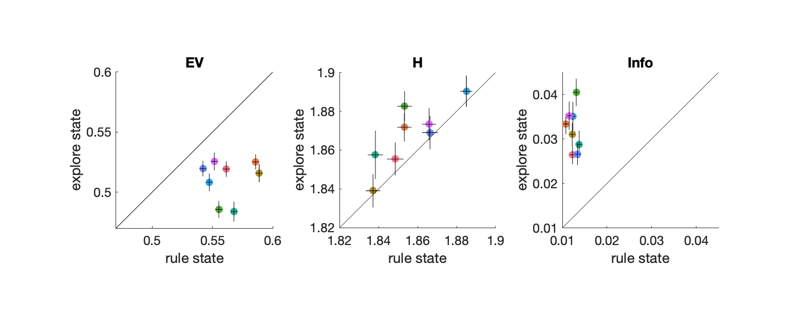
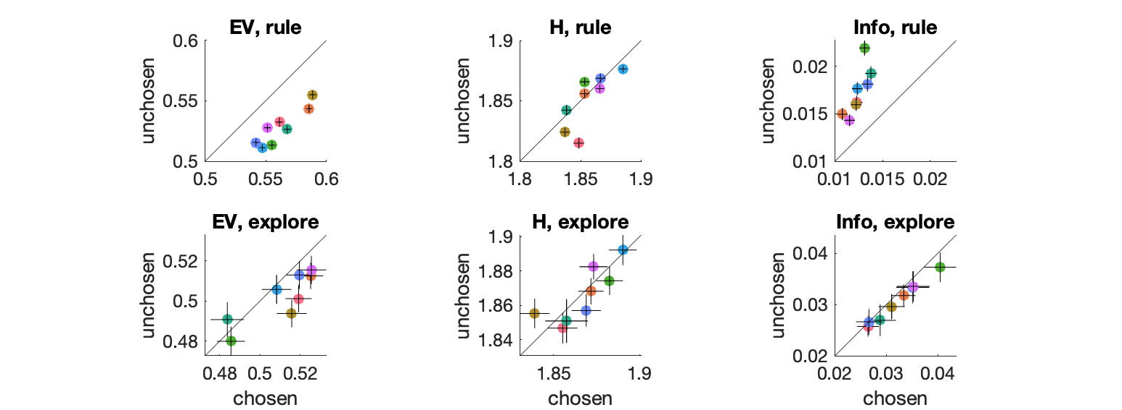
Exploration maxes information gain

Slide 10
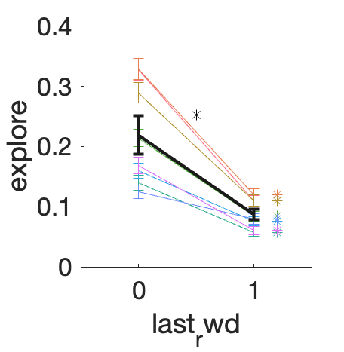
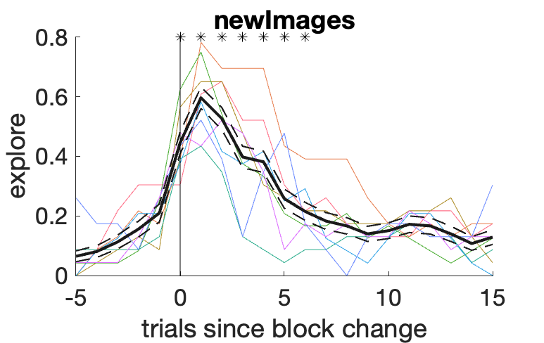
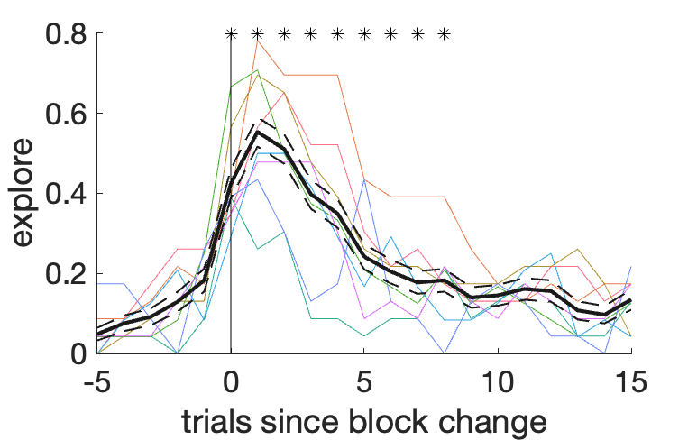
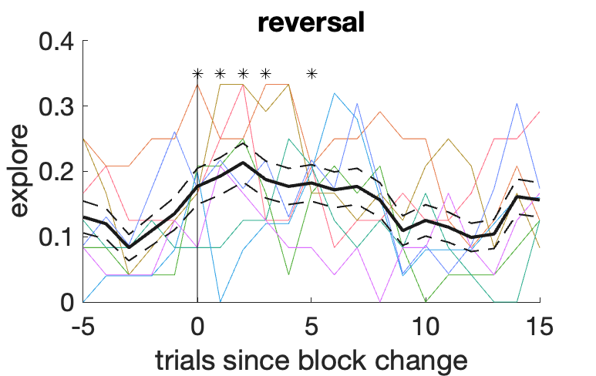
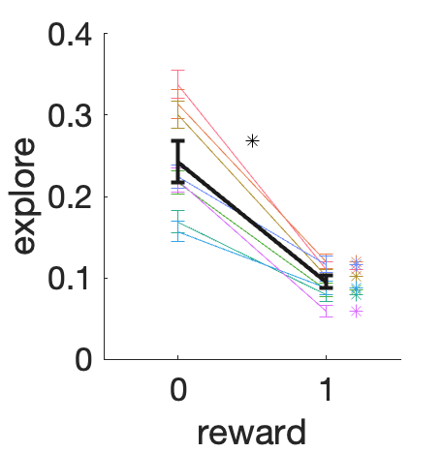
Some basic behavior

Slide 11
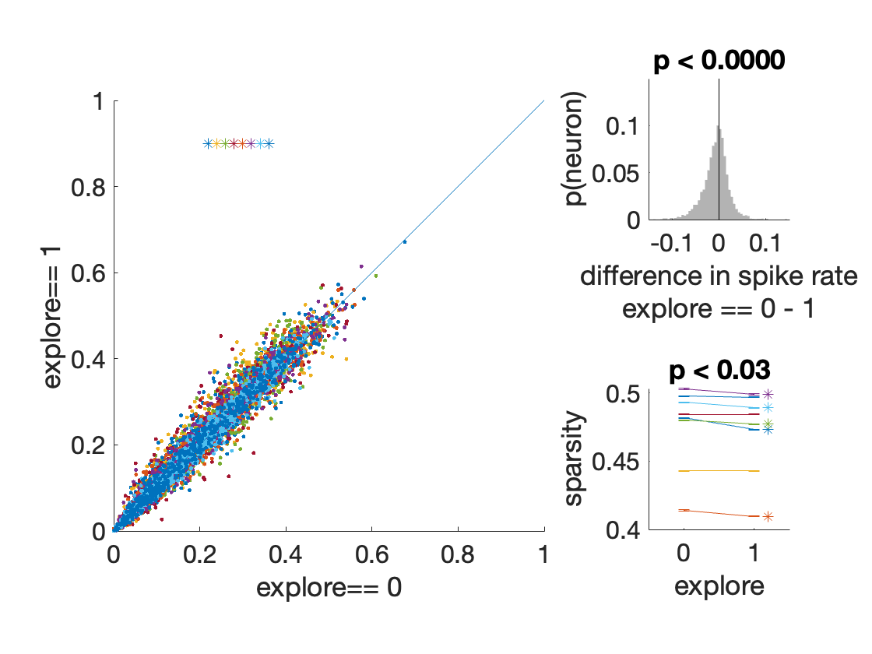
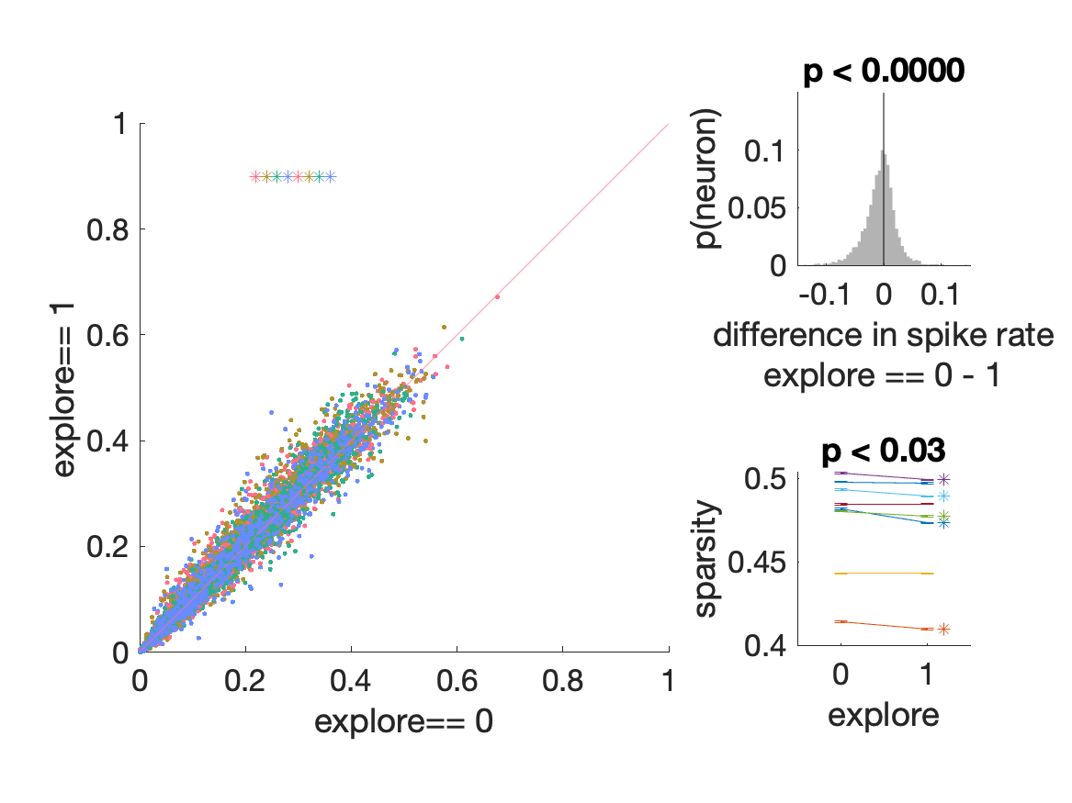
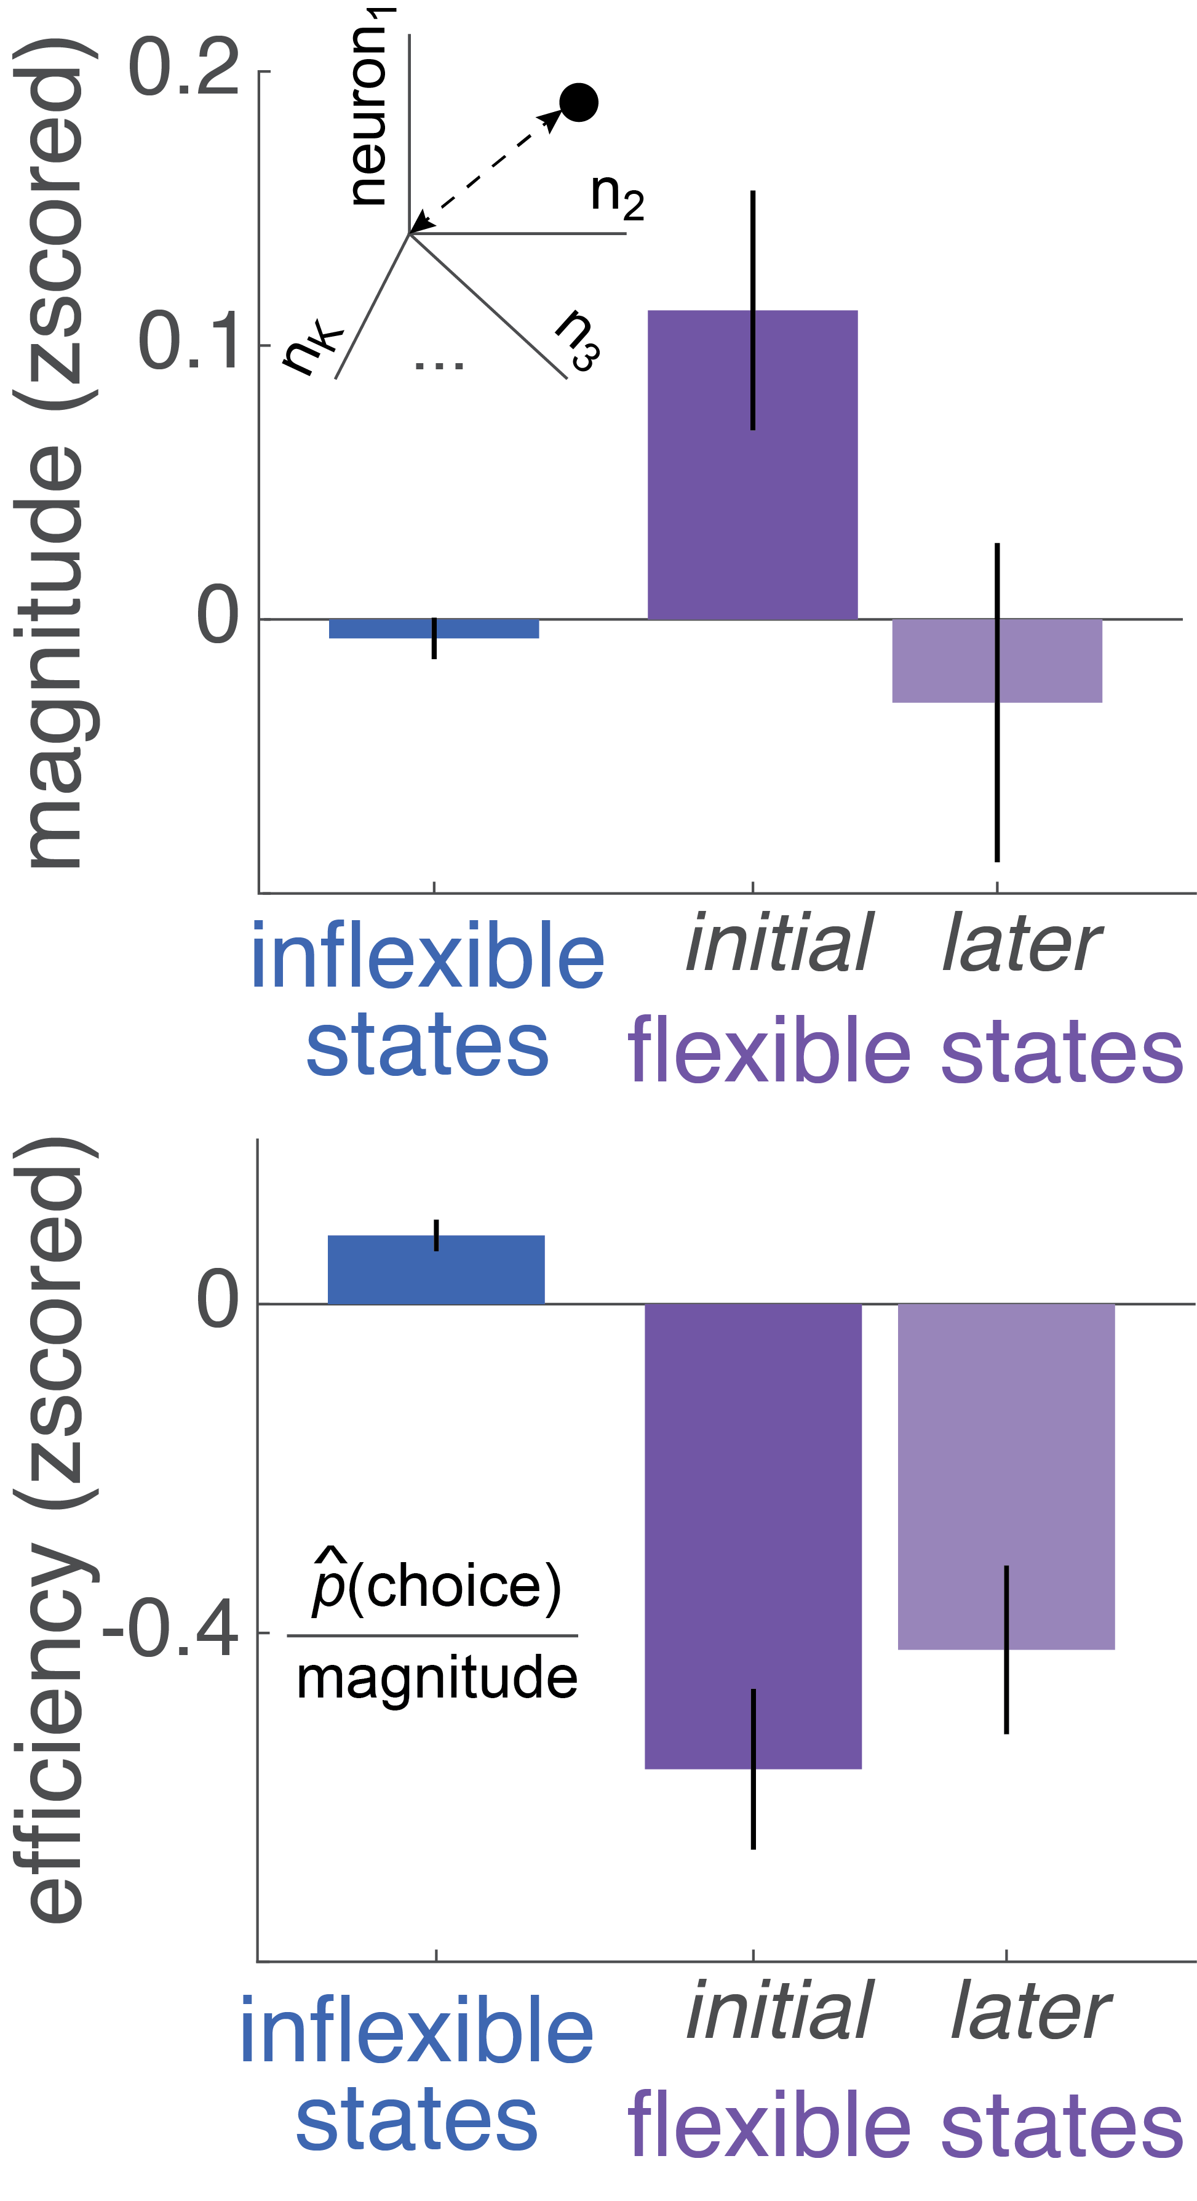
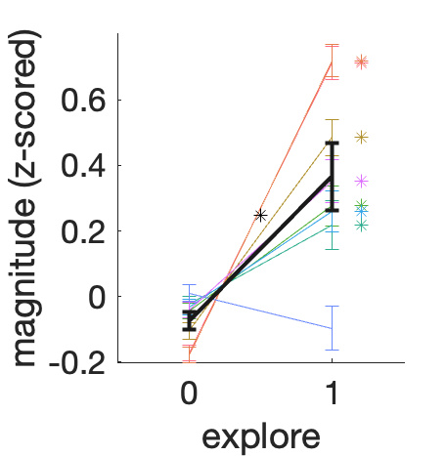
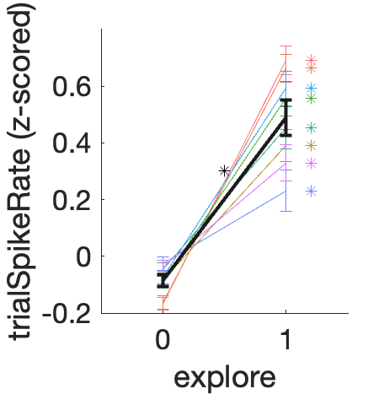
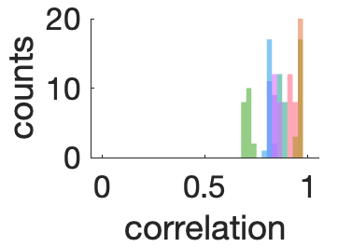
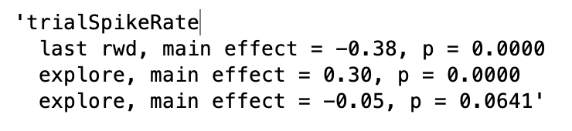
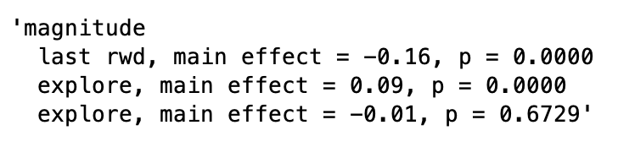
Neural data analyses
Spiking activity is higher
during exploratory decisions.
We would expect this to show up as a change in magnitude at the population level
not due to last reward:

Slide 12
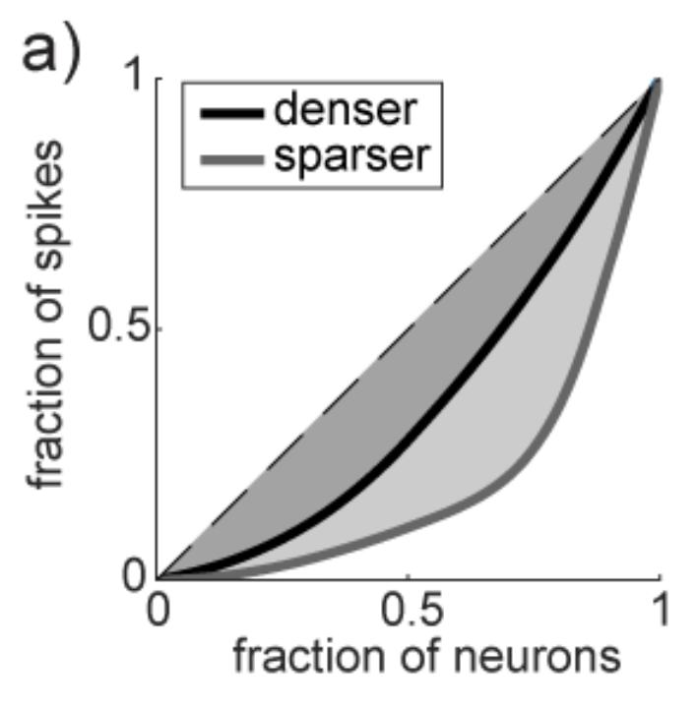
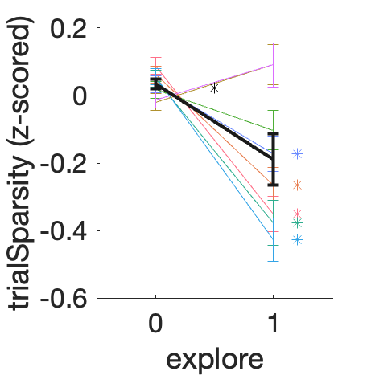
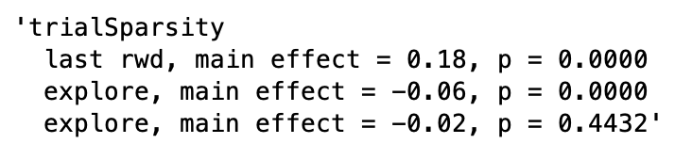
Spiking activity is also denser during exploratory decisions.
would be nice to illustrate an example session for the sparsity; this is a cartoon
not due to last reward:

Slide 13
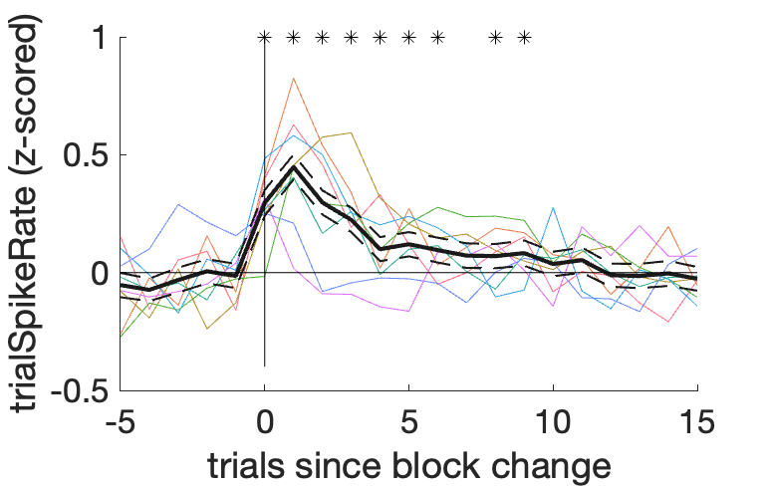
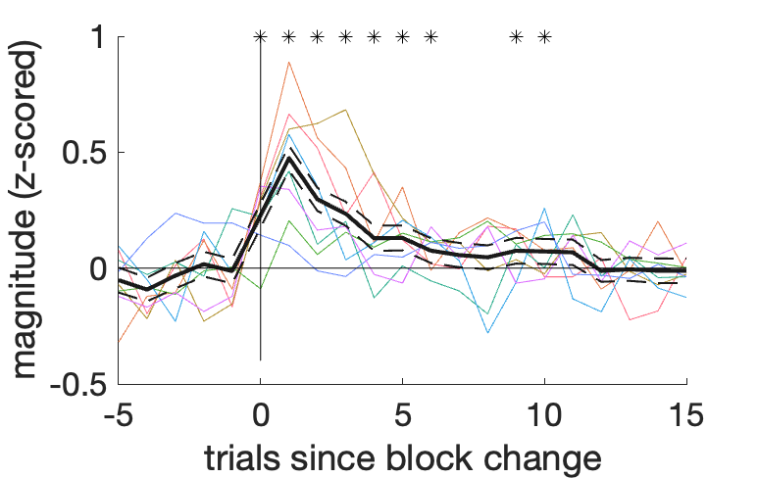
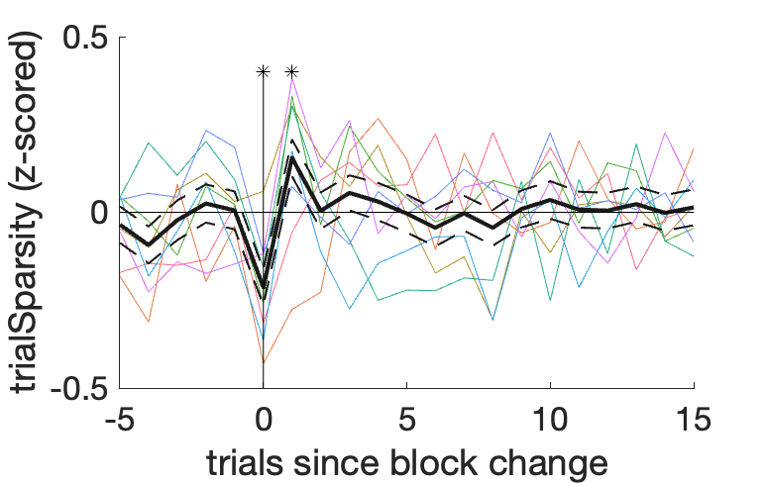
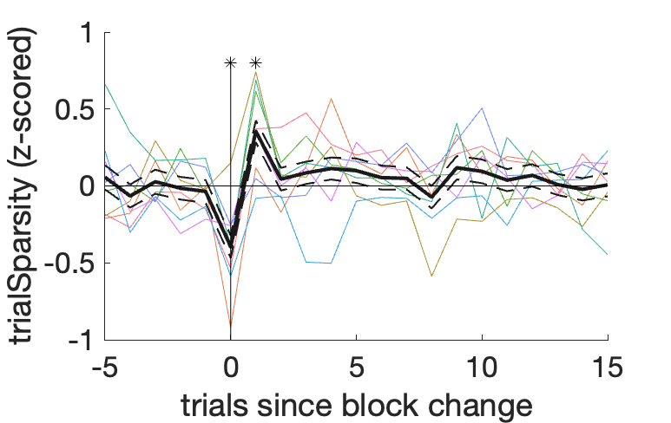
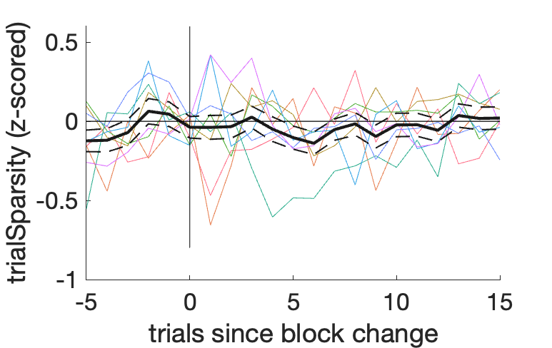
The increase in spike count and density, aligned to block changes
new images
reversal
need to show the new images/reversal
distinction for the spike rate and magnitude
- makes the point that those are more similar

Slide 14
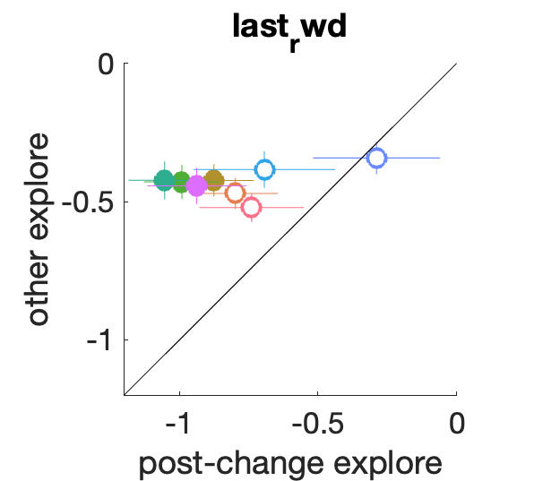
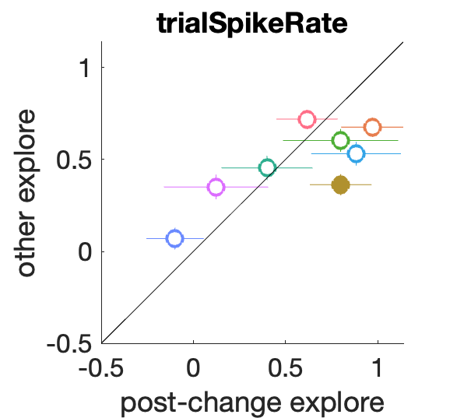
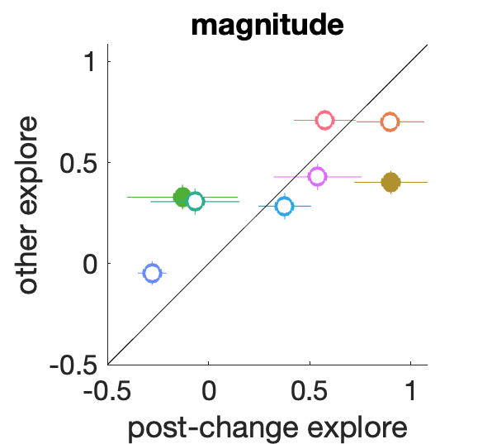
The increase in spike rate / magnitude is present on all explore choices, not just after reversal
these are w/in 5 trials of the change pt
Notes:
also should show sparsity here – as counter example – NO! it’s too precise for the change point itself

Slide 15
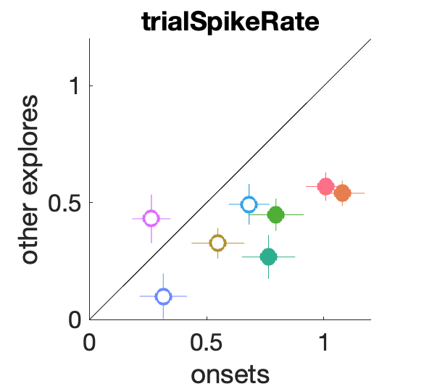
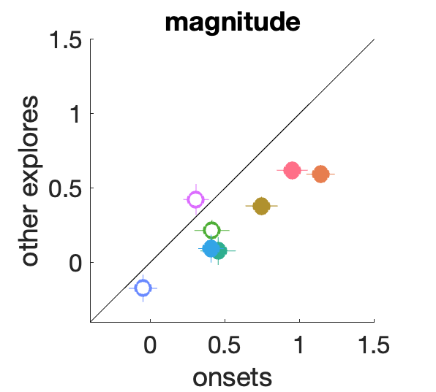
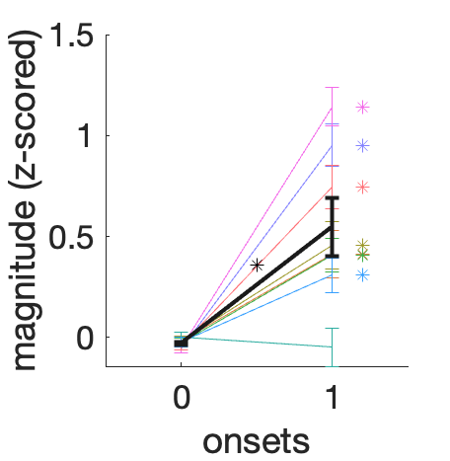
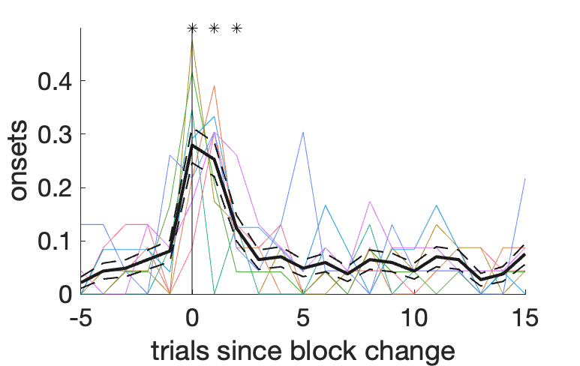
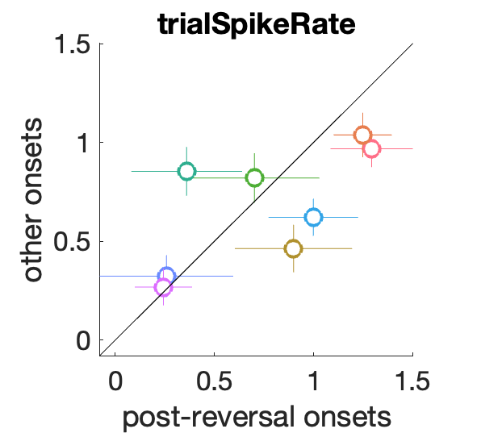
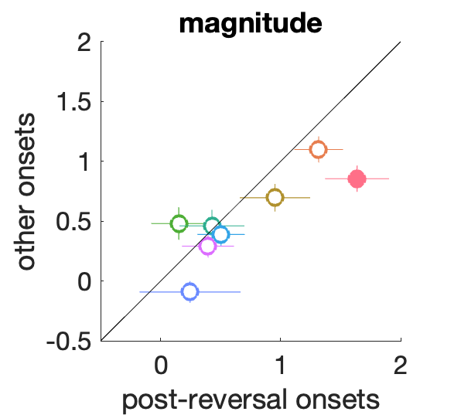
Onsets, not reversals, are driving the increase in magnitude and avg. firing rate,
not related to reversals,
just related to the behavioral change

Slide 16
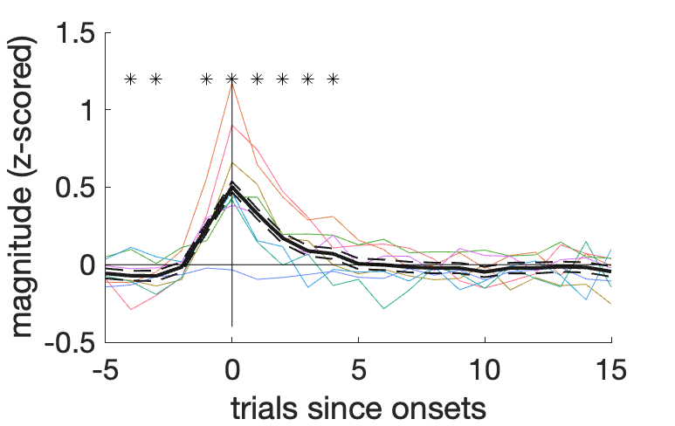
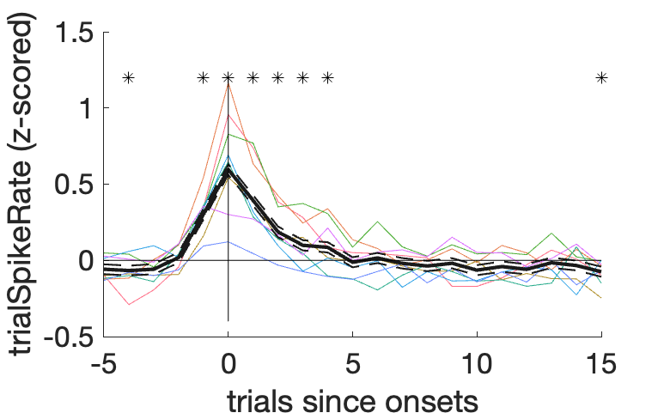
neural measures aligned to onsets

Slide 17
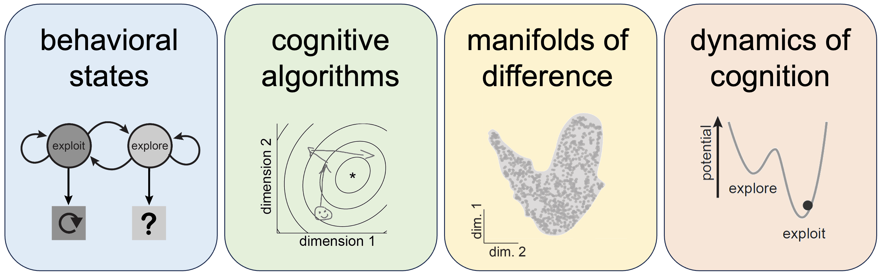
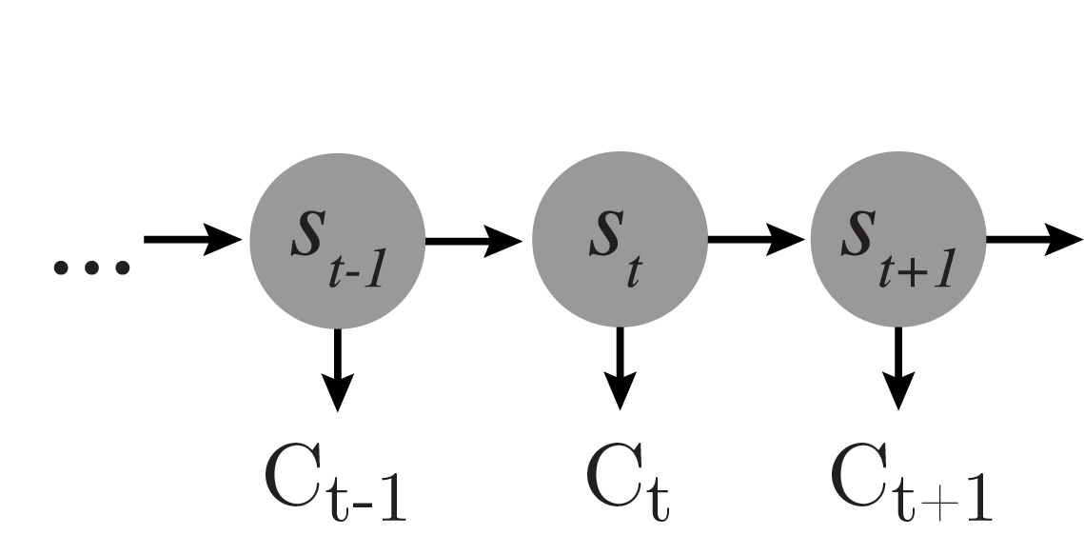
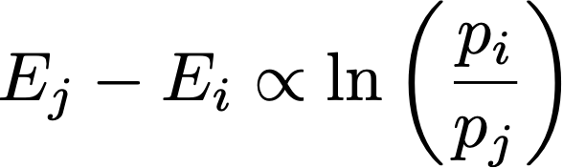
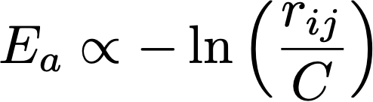
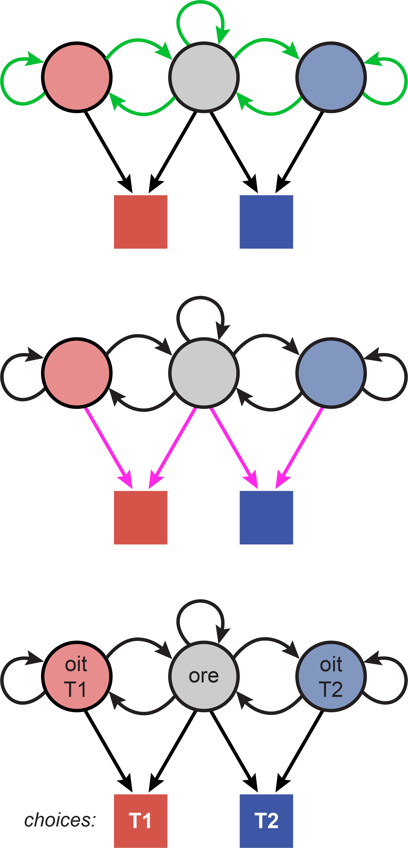
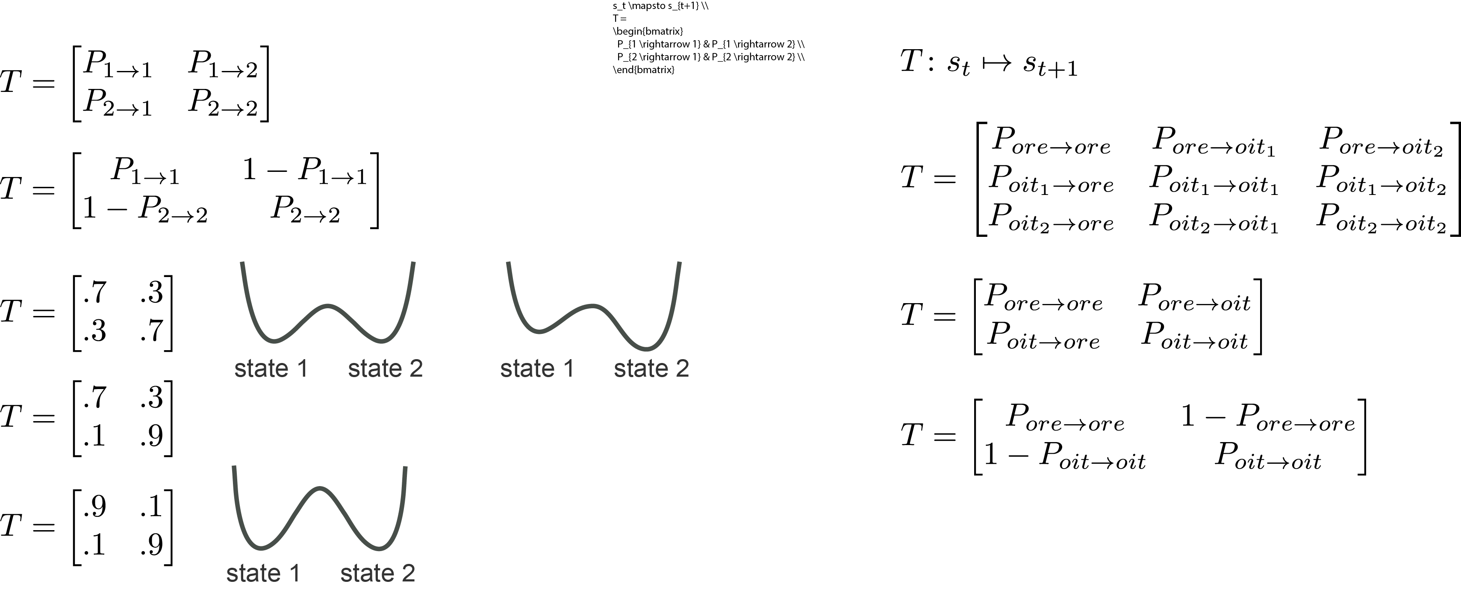

Measuring cognitive dynamics
Boltzman distribution
Arrhenius equation
transition
matrix
emissions
model
Ebitz, et al., PLoS Comp Bio 2018;
Chen, et al., Elife 2021
Ebitz, Albarran & Moore, Neuron 2018;
Chen, Knep, Han, Ebitz & Grissom, Elife 2021
Notes:
ar-aine-ious equation

Slide 18

Bump graphs work in this dataset
Explore is deeper than exploit, consistently

Slide 19



Session-by-session variability in activation energy (barrier height) predicts the neural costs at onset
Notes:
inferring the costs of switching from behavior
then asking if the costs that are paid match that?
there's an ambiguity in the interpretation
do you switch more because of the neural activity being different
or do you switch less because the costs are up
just asking if there was higher activity or differences in activity on the sessions where they switched more frequently - like overall - is there a way of doing this???
can we just look agnostically at how variable neural activity is across trials??

Slide 20
So what do rewards do?
Mediation analysis – reward omissions cause the change in activity that predicts the onset of exploration. Omissions do the work!
So how does that work? How does that interact w/ the thermodynamic models?
One idea is that omissions do the same thing every day – they do the same amount of work – if that’s the case, then the animals should be *most* sensitive to rewards on days when the barrier height is low.
The alternative is that omitted rewards do more work on the sessions in which more work is required—the brain pays the cost of transforming the same reward outcome into a bigger stimulus.
so ask whether barrier height predicts the neural or behavioral effects of omitted rewards???

Slide 21



Rewards do the work?
Hypothesis: If omitted rewards are the force that pushes us out of the exploit basin in order to explore, then omitted rewards should have the biggest impact on neural activity during the sessions where they must do the most “work” on the system
Alternatively: rewards could have different impacts on different sessions – heavy weight when barrier is high, etc. – but that’s not what we see!
We see highly similar outcome weights across sessions – there seem to be a largely conserved pattern of reward effects?
so this is not explained by differences in the effects of reward on behavior?
Notes:
look at the variance in single trial neural activity – do rewards increase this variance???

Slide 22
Rishabh has a paper from an HMMI lab that looks at the link between sparsity and drift/representational learning
Devin is curious about the w/in trial dynamics of this
and Meriam brings up the fano factor here - compare new and old images
and also the reversals vs. the nons and the changing goal states
show that the other 2 are true for both new images and reversals
in the timecourse analyses – only sparsity has weird dynamics
Mojtaba would like to look at the anatomy - the distribution of neurons across the 2 axes

Slide 23

What is our motivation here?
Decrease during exploitation or increase during exploration?
Energetic demands?
General property?

Slide 24
Figure 1: Task design and model
data: Bartolo & Averbeck, Neuron 2020;
Tang, Bartolo, Averbeck, Nat Comms 2021
maybe: model predicts explore is less stable than exploit; so it should be more energetically demanding?
Notes:
novel stimuli are introduced at the block change; so can’t exploit images that way

Slide 25
Figure 2: Spiking activity is higher and denser during exploratory decisions.
would be nice to illustrate an example session for the sparsity; this is a cartoon
not due to last reward:

Slide 26
Figure 2, cont: The increase in spike count and density, aligned to block changes

Slide 27




Figure 2, cont: Only the increase in spike rate / magnitude is present on all explore choices, not just after reversal
these are w/in 8 trials of the change pt which is the the number of bins w/ a sig increase in p(explore)

Slide 28
Figure 3: Onsets, not reversals, are driving the increase in magnitude and avg. firing rate,
not related to reversals,
just related to the behavioral change

Slide 29


these are sig before the change too, but struggling a bit with how to measure
at least for the case of spike count, this is not a byproduct of any effect of last reward

Slide 30

these are sig before the change too, but struggling a bit with how to measure
at least for the case of spike count, this is not a byproduct of any effect of last reward

Slide 31


Slide 32
Figure 3,cont: Session-by-session variability in activation energy (barrier height) predicts the neural costs at onset

Slide 33
Same thing in another dataset?
does session by session variability
predict the barrier height here too?
NO – it does not – only see this increase
in magnitude at the outset, but not corr by barrier height
but would be useful to look at whether there is magnitude predicting onsets independently of reward omissions in this dataset
magnitudesAndInfo_AFOSR

Slide 34

Pupil size predicts magnitude...
magnitudeByPupil_pupilExploreProb

Slide 35



Arrhenius equation

